Slide 1
Performance metrics for Cluster analysis
Clustering is unsupervised learning i.e no ground truth class labels are given most of the time.
Internal validation measures : if ground class labels are not given. E.g. Silhouette measure
External validation measures : if ground class labels not given. E.g. Rand Index, Jaccard index

Slide 2
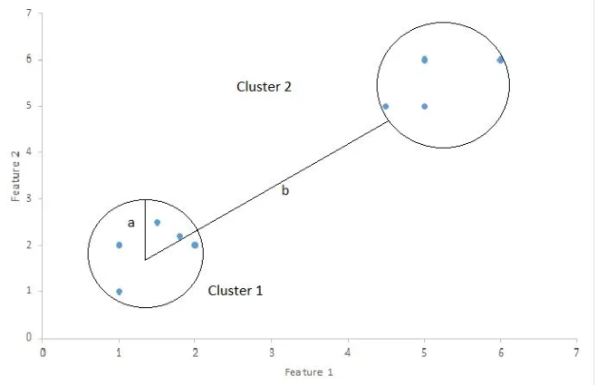
Silhouette Index
Silhouette index is used to calculate the goodness of a clustering technique.
1: clusters are well apart from each other.
0: distance between clusters is negligible
-1: clusters are assigned in the wrong way.
Silhouette Score = 1 – (a/b)
a= average intra-cluster distance i.e the average distance between each point within a cluster.
b= average inter-cluster distance i.e the average distance between all clusters.

Slide 3
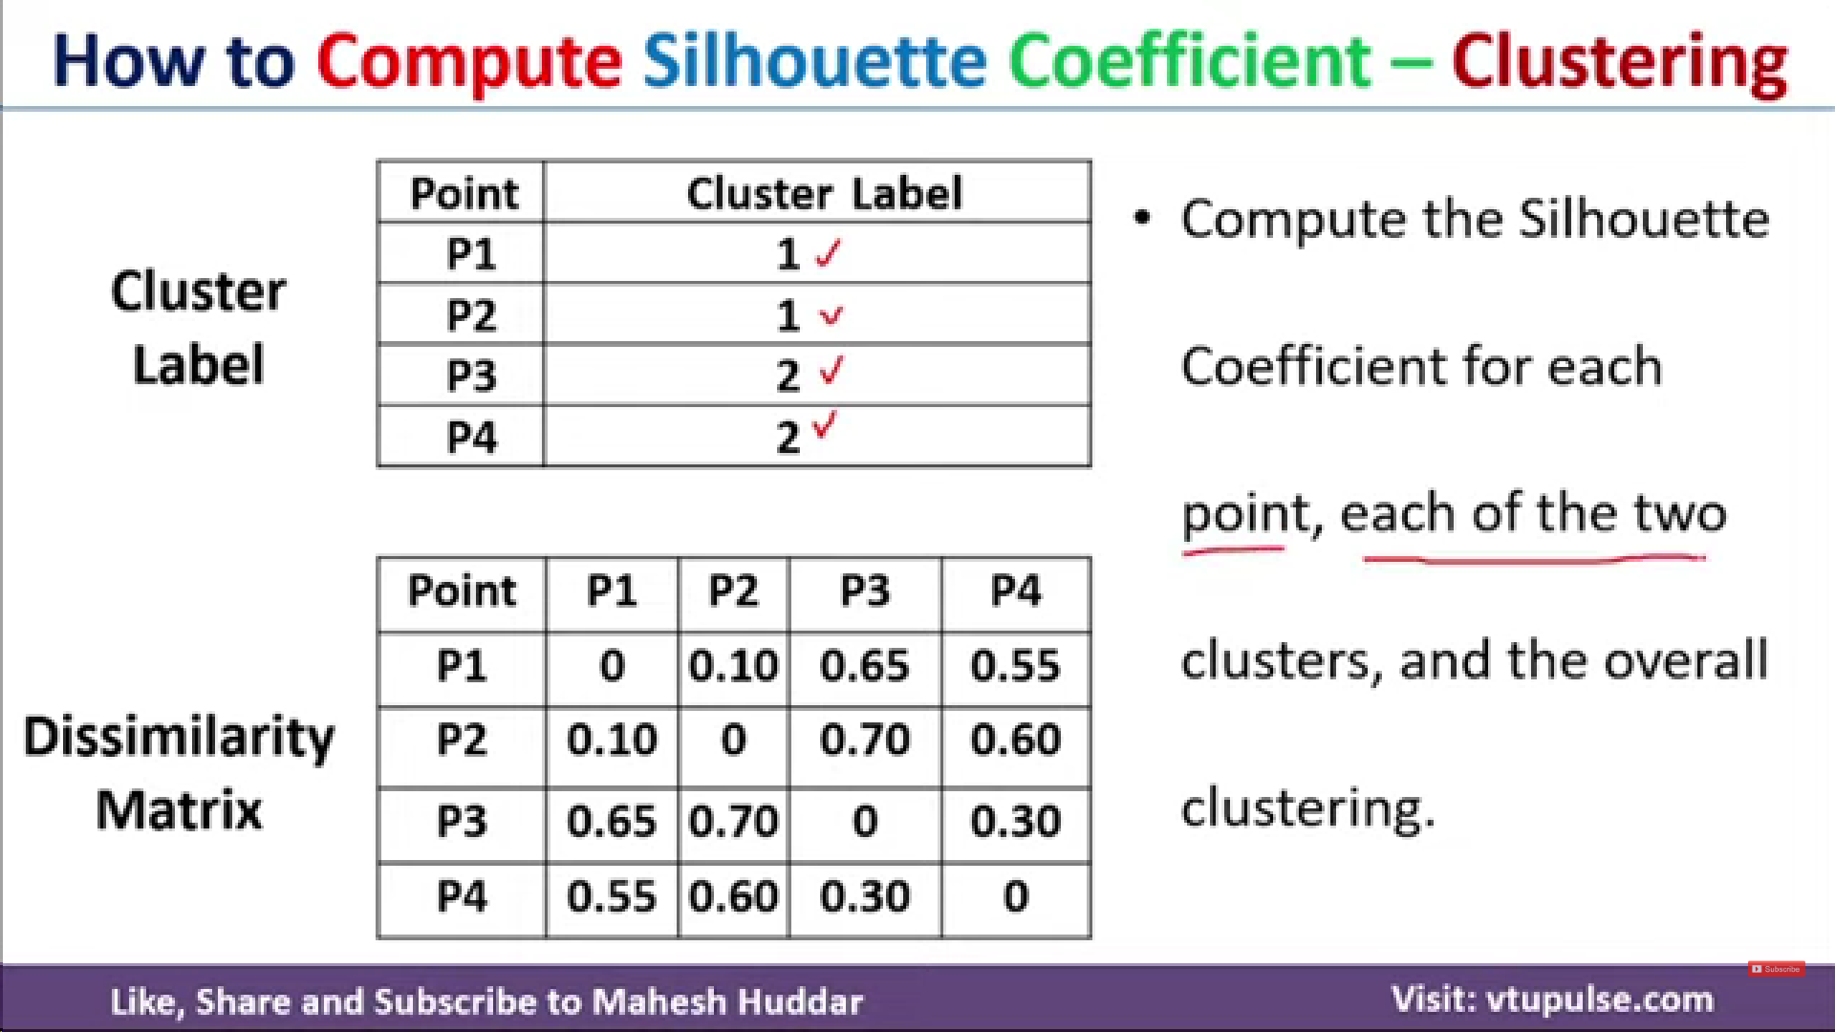
https://youtu.be/FGXkbawTHRQ?si=HftdJIydcdMWAKBn

Slide 4
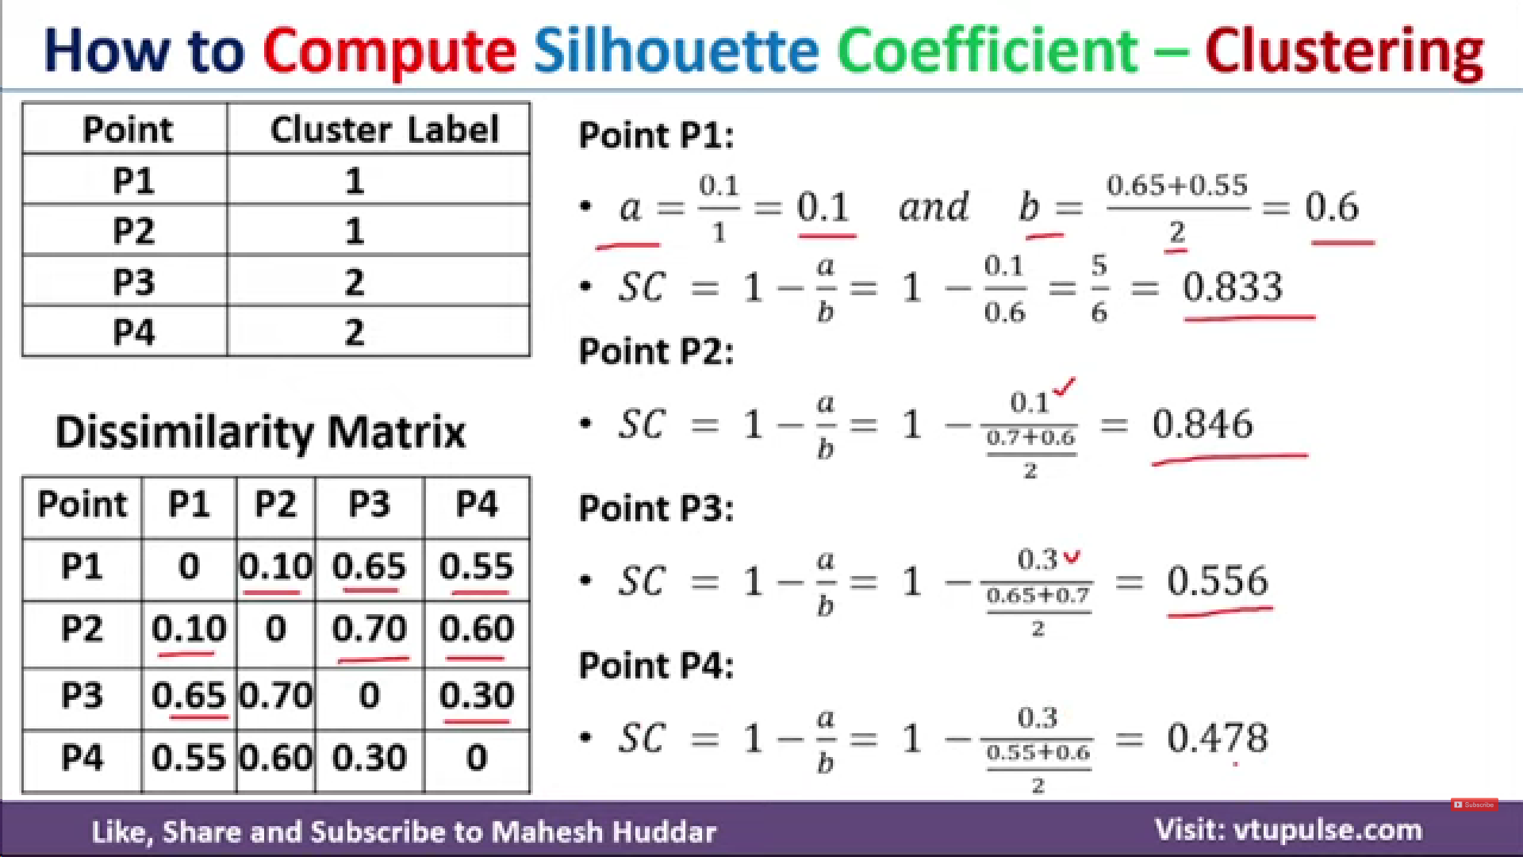

Slide 5
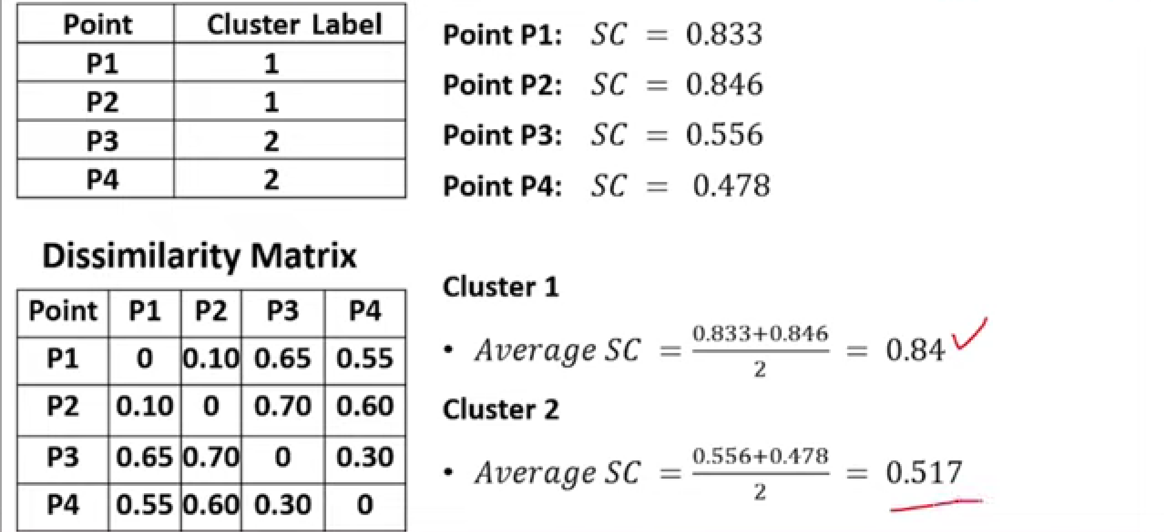
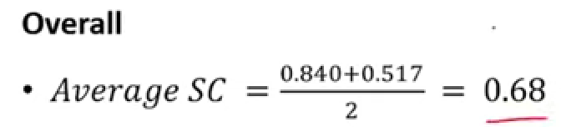

Slide 6
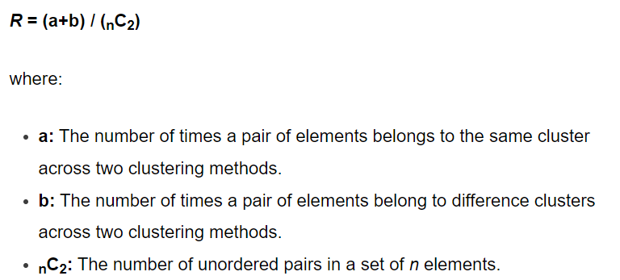
Rand Index
The Rand index is a way to compare the similarity of results between two different clustering methods.
0: Indicates that two clustering methods don’t agree on the clustering of any pair of elements.
1: Indicates that two clustering methods perfectly agree on the clustering of every pair of elements.

Slide 7
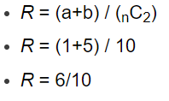
Rand Index Example
https://youtu.be/6rjTIwn0yWI?si=Up4IOu8SYDWNrvhn
Dataset: {A, B, C, D, E}
Method 1 Clusters: {1, 1, 1, 2, 2}
Method 2 Clusters: {1, 1, 2, 2, 3}
To calculate a, which represents the number of unordered pairs that belong to the same cluster across both clustering methods:
{A, B} In this case, a = 1 [In cluster 1: (A,B) = (1,1) and in cluster B: (A,B) = (1,1)]
To calculate b, which represents the number of unordered pairs that belong to different clusters across both clustering methods:
{A, D}, {A, E}, {B, D}, {B, E}, {C, E} [In cluster 1: (A,D) = (1,2) and in cluster B: (A,D) = (1,2)]
In this case, b = 5. [In cluster 1: (A,E) = (1,2) and in cluster B: (A,E) = (1,3)] ….

